Slide 1
Intro to Design Patterns
Lecture 2.2 – Template Method Pattern

Slide 2
Notes About Code & Presentation
Code Style
Compressed to fit in vertical space
Namespaces
Use to support code folding and group evolution of code
Comparisons
Code presented side-by-side as much as possible
Text and Other Explanations
Typically on slide before code to maximize space for the code itself
Expect 3 namespaces, <dp>_legacy, <dp>_problem, <dp>_solution
Read the comments

Slide 3
Reading
DPE
Chapter 14 – The Principles and Strategies of Design Patterns
Chapter 19 – The Template Method Pattern

Slide 4
If the Steps are varying use the Template Method pattern
Technique
Public function in base class to execute the steps.
Protected functions for each step.
Those that vary are virtual.
Derived classes redefine the steps that vary.
Benefits
Client code uses classes polymorphically.
Sequence of steps defined only once.
Follows open/closed principle.
Alternatives suffer from code duplication, obscurity, multiple seam points, violate open/closed principle, and require error handling.

Slide 5
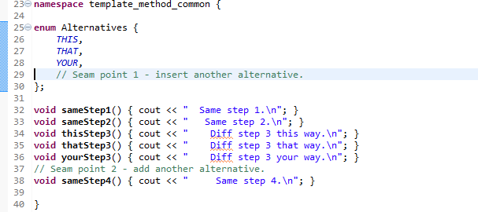
Code Common to the Examples
Common process where most steps are the same.
One (step 3) is varying depending on the “alternatives”.
The enums and functions result in 2 seam points, one (#1) where existing code has to be modified - violates open/closed principle.

Slide 6
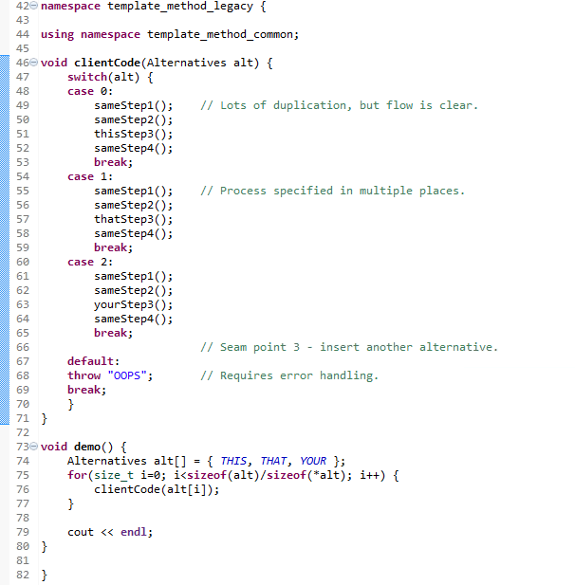
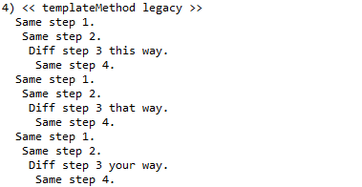
Legacy Example
A 3rd seam point, violates open/closed principle.
Lots of duplication.
Process is specified in multiple places.
Requires error handling.

Slide 7
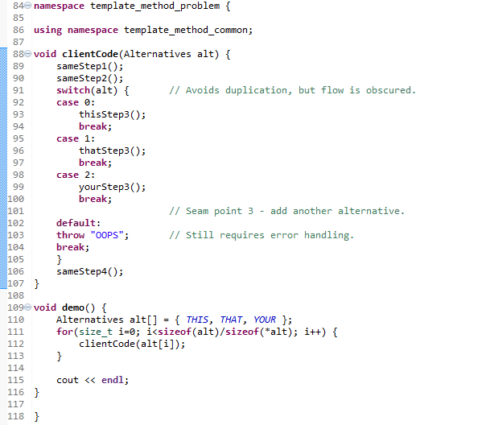
Legacy versus Problem

Slide 8
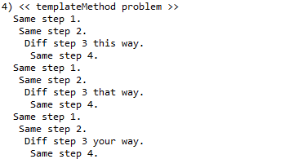
Problem Example
Still have a 3rd seam point, violates open/closed principle.
Have removed duplication, but flow is obscured.
Still requires error handling.

Slide 9
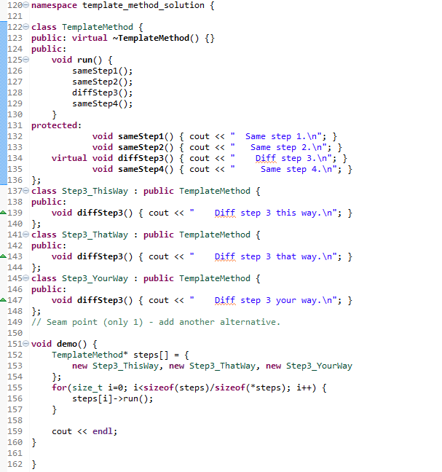
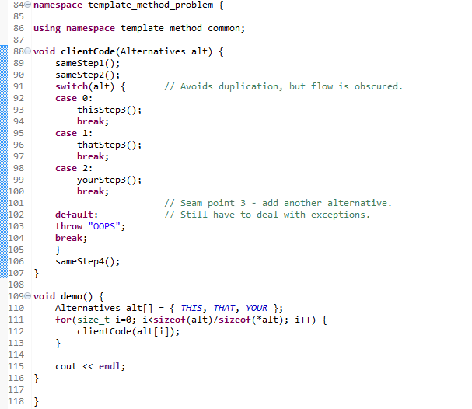
Problem versus Solution

Slide 10
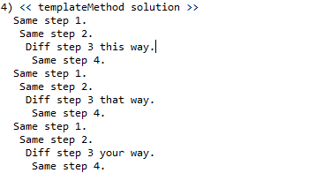
Solution Example
Process is specified in only one place (TemplateMethod.run()).
Have only one seam point, follows open/closed principle.
Client code uses classes polymorphically.

Slide 11
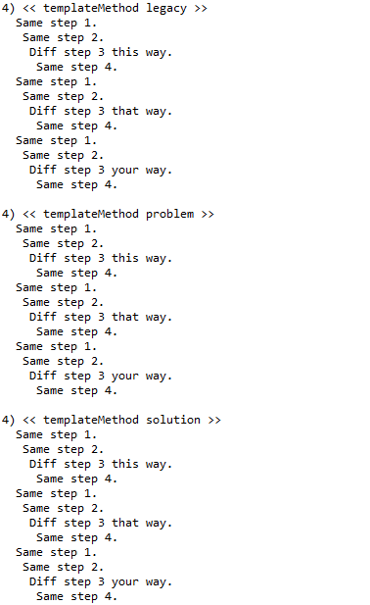
Output

Slide 12
Summary
When the steps are varying, use the Template Method pattern to encapsulate the variations.
Public function in base class to execute the steps.
Virtual method for each step that varies.
Derived classes override the steps that vary.
Minimizes code duplication, preserves process clarity.
Easy to add alternatives – follows open/closed principle.

Slide 13
Class Progress
If the algorithms are varying
If the interfaces are varying
If the API’s are varying
If the steps are varying
If the classes are varying
If the options are varying
If the listeners are varying
If the responders are varying
If abstract’n & implement’n vary
If the families are varying
Use the Strategy pattern
Use the Adapter pattern
Use the Facade pattern
Use the Template Method pattern
Use the Factory Method pattern
Use the Decorator pattern
Use the Observer pattern
Use Chain of Responsibility pattern
Use the Bridge pattern
Use the Abstract Factory pattern

Slide 14
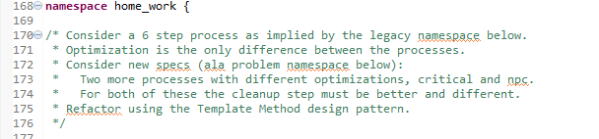
Homework
<Transition to IDE>

Slide 15
Backup Slides

Slide 16
